Slide 1
Innovation for AAL
Notes:
juan

Slide 2




Meet our Team
Luis Alarcon CSCE 22’
Santana Gonzales
ITDE 23’
Juan Perez
ISEN 21’
Mualla Argin
CPSC 23’
Notes:
juan

Slide 3

Problem Statement
There is no agreed-upon way to determine if innovation activities are creating real value for the DoD/Army.
Basket of metrics that reflect potential success of AAL’s companies
Tool to monitor these metrics
Notes:
Juan

Slide 4

Initial Thoughts
Assumptions:
AAL would have reliable and enough data to create KPIs
AAL would collect the same data for every project
AAL project managers can tell their customers what to do and how to do it
Approach:
Clean AAL’s data
Create KPIs from data
Present it with a dashboard
Notes:
juan

Slide 5

Business Thesis
Our team will identify KPIs that the Army Applications Lab can use to evaluate the success of innovation projects
Notes:
Juan

Slide 6
Customer Discovery
Notes:
Santana

Slide 7
Customer Interviews
35 Interviews Completed
100+ Cold Calls/Emails/Linkedin Requests
15 articles
‹#›
Notes:
Mualla

Slide 8

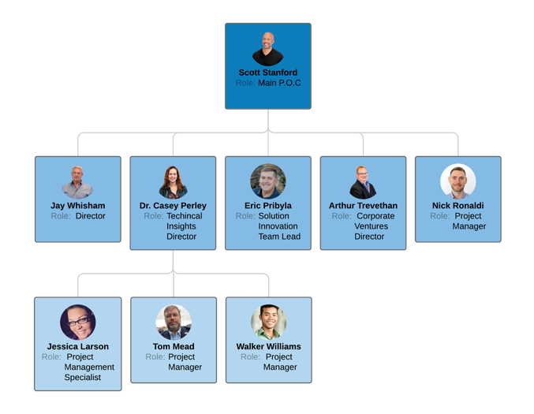
Customer Discovery -
AAL
Notes:
Santana

Slide 9
Customer Discovery -
AAL
Dr. Perley
Key insights to AAL and on current data
Feedback on our metrics
Project Managers
AAL / Team interactions
AAL’s Contracting information
Cohesion throughout PMs
COL Whisham
Push for future metrics
Notes:
Santana

Slide 10
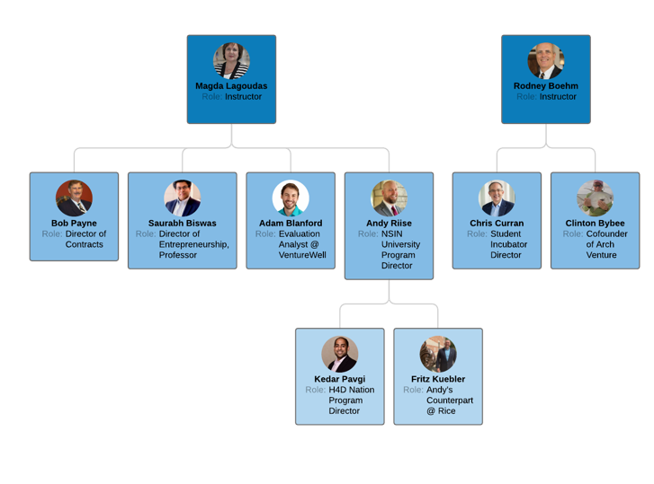
Customer Discovery -
Industry
Notes:
Santana

Slide 11

Customer Discovery -
Industry
Kedar Pavgi - NSIN
Push to talk to more project managers
Chad Lewis - Peak Nano
Measuring progress using milestones
Dr. Biswas - Entrepreneurship at TAMU
Push to track TRL’s for each project
Notes:
Santana

Slide 12

Customer Discovery -
Research
McKinsey & Company 1
Established KPIs for innovation and success
Institute of Electrical and Electronics Engineers 9
TRL assessments
TRL Stages
VentureWell 2
Tangible progression indicators
Create a Framework for innovation success
Notes:
Santana

Slide 13

What We Learned
AAL Background
2 Main Customer Segments
AAL vs Industry Norm
AAL’s pain points
Business Communication
Customer Interviews
Notes:
Mualla

Slide 14

Pivot
Notes:
Luis

Slide 15

Final Approach
Give AAL the necessary methods to gather the right data
Train their employees and program managers to use the proper tools and methods
Track the proper metrics and score projects accurately
Notes:
Luis

Slide 16
Innovation Framework
Standardization
Quantitative
Analysis
Standardization
Qualitative Tracking
Our 3 steps to track and measure the success of innovation within your organization
Data Evaluation
Notes:
Luis

Slide 17
Questions?
Notes:
Mualla

Slide 18
References:
https://aal.army/
https://aal.army/what-we-do/
https://aal.army/our-team/
Research Articles:
https://www.mckinsey.com/business-functions/strategy-and-corporate-finance/our-insights/how-to-take-the-measure-of-innovation
https://venturewell.org/venture-development-framework/
https://scholarworks.alaska.edu/handle/11122/5635
https://www.sbir.gov/sites/default/files/1_outreach-ipc_report.pdf
https://api.army.mil/e2/c/downloads/404585.pdf
https://techlinkcenter.org/news/technology-readiness-level-dod/
http://citeseerx.ist.psu.edu/viewdoc/download?doi=10.1.1.562.3338&rep=rep1&type=pdf
https://web.p.ebscohost.com/ehost/pdfviewer/pdfviewer?vid=1&sid=733765cb-c6f3-41fa-a84e-183770ded929%40redis
https://ieeexplore.ieee.org/abstract/document/5747634?casa_token=Edk3oouYmDQAAAAA:3IYlZpDAiK2bQm-MwLGd7m0TD-HKSncHVqSVcO8DEPfRac2MJbj0GquqcA32k3PVcuL2r4lJFA

